Slide 1
Customer Segmentation for a Digital Loan Provider

Slide 2
agenda
Feature Engineering
Clustering Technique
Customer Segmentation Analysis
Strategic Roadmap & Recommendations

Slide 3
Feature Engineering
The significance of additional data :
Payment Ledger: It helps to track all transactions to ensure accurate reconciliation of payments and outstanding balances.
Repayment Ratio: It gives a better look into the financial discipline and serves as a good behavior measure.
Average number of days to repay: It assesses repayment efficiency and customer’s liquidity.

Slide 4
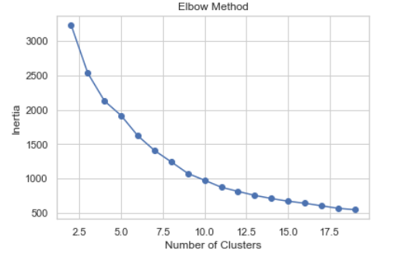
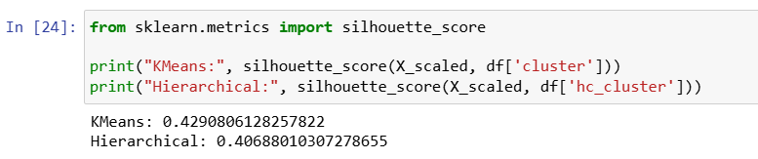
Clustering Technique: K-Means
Since the data consists of some amount of overlap and outliers (e.g. zero repayment for whole year), hierarchal clustering didn’t perform well.
No. of Clusters were determined by:
1. Elbow Method
2. Silhouette Score
3. No. of Segments/ Clusters: 5

Slide 5
Segment Name | Behavioural Characteristics | Business Interpretation
Cluster 2: The Power Revolvers | High num drawdowns, high repay within 1 day | They move huge amounts of money and have a near-perfect repayment ratio (0.94) and the fastest repayment speed.
Cluster 3: The Steady Reliable | High avg monthly drawdown , High frequency (136 drawdowns); 1.02 repayment ratio. | The "Perfect" customer. They borrow frequently, and they pay back exactly what they take (plus a little extra, likely fees/interest).
Cluster 1: The Emerging Users | Have successful applications but low drawdown volume. Moderate activity; low repayment ratio (0.45) | They are borrowing more than they are paying back right now. They might be in a growth phase or newly onboarded.
Cluster 0: The Slow Burners | Highest avg days to_epay (126 days). | Low frequency and very slow to pay. They aren't necessarily "bad," but they have a very long capital cycle.
Cluster 4: The Critical Outliers | Zero repayments; $13.8M pending balance. | This cluster represents accounts that have borrowed massive amounts but have zero recorded repayments. These are either massive defaults or technical data errors.
Customer Segmentation Analysis

Slide 6
Strategic Roadmap & Recommendations
Retain & Scale (Clusters 2 & 3): Increase credit limits for High-Velocity Whales. They are "safe" capital movers.
Optimize Liquidity (Cluster 0): Introduce “Early Bird" discounts or shorter drawdown windows for Slow-Burners to unlock frozen capital.
Monitor & Educate (Cluster 1): Provide cash-flow dashboards to Emerging Growth merchants to help them reach a 1.0 repayment ratio.
Immediate Mitigation (Cluster 4): Action: Immediate "Circuit Breaker" on new lending. Conduct a manual audit to distinguish between technical data errors and genuine default risk.

Slide 7
Thank you
Rishika Arora
rishikaarora028@gmail.com

